Slide 1
Eliminating Disparities and Building Health Equity: A Justice Approach
Delaware Department of Health and Social Services
State Opioid Response Network (SOR) Conference 2024
Innovative Strategies for Engaging Key Populations
May 29, 30, 2024, Wilmington, DE, 2024
Haner Hernandez, Ph.D., CPS, CADCII, LADCI
hanerhernandez@aol.com
413-627-1601
Notes:
Place your title on this first slide and include any subtitle.
DO NOT CHANGE THE FORMAT OF THIS TEMPLATE. If you are creating ATTC-branded slides, you must use this template. If you move around boxes, make sure to check the reading order. If you widen any boxes they must not overlap any other box.
IF YOU ADD ANY GRAPHICS, you will need to add ALT TEXT and check READING ORDER.
(If the notes on ALT TEXT and READING ORDER do not make sense to you, please let the ATTC National Coordinating Office know to help with remediation.)

Slide 2
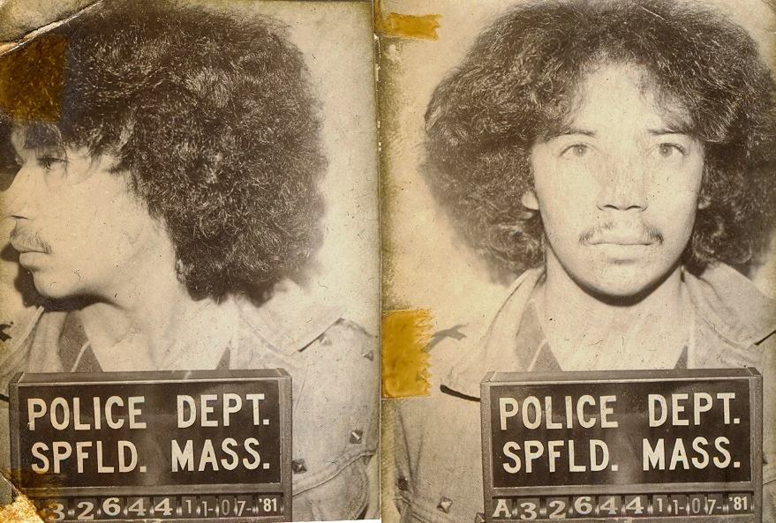
And, I Earned my GED in Prison!
Yes, I Earned a PhD, CPS, CADCII, LADCI
Notes:
I am a person in long-term recovery: 36 years and 9 months!
My recovery enables me to be a productive member of my Familia, my community, and to make a contribution in the lives of others. I no longer live with the shackles of incarceration, poverty, hopelessness, shame and guilt.
And I am much more than that: I am also a Puertorriqueño - Boricua, a Grandson, a Son, a Brother, a Father, a Cousin, and Friend. I am a work in progress.

Slide 3
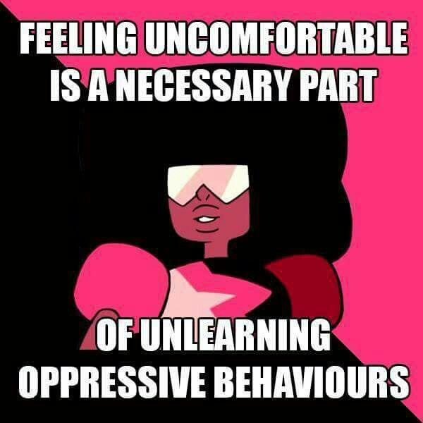

Slide 4
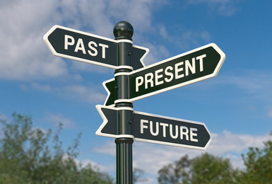
History
Matter!
Context

Slide 5
Mantra: Addiction and Mental Health Don’t Discriminate!!
WHAM

Slide 6
Deliberate Silos

Slide 7
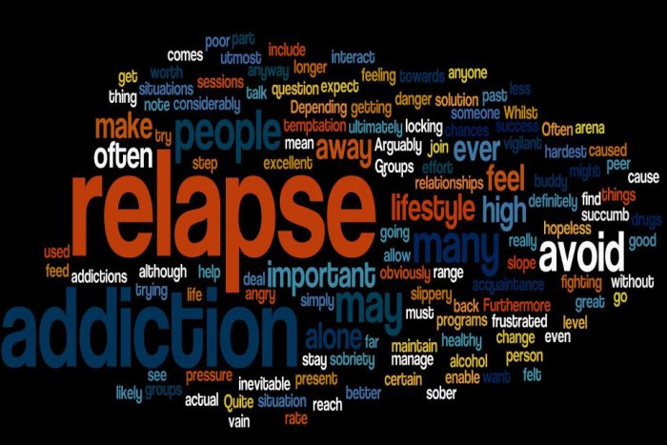
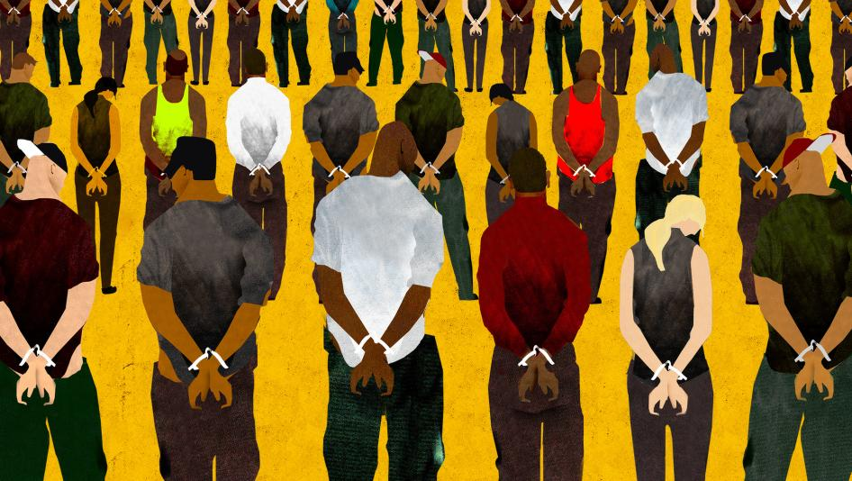
Punitive Approaches

Slide 8
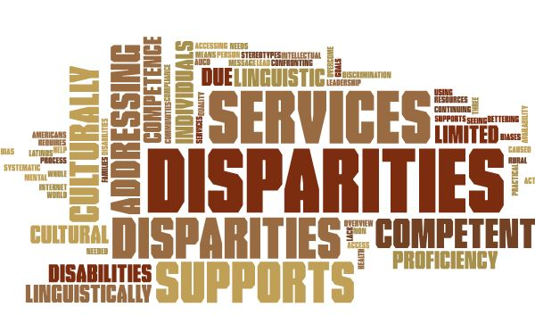
Disparities
“Particular type of health difference that is closely linked with social, economic, and/or environmental disadvantage. Health disparities adversely affect groups of people who have systematically experienced greater obstacles to health based on their racial or ethnic group; religion; socioeconomic status; gender; age; mental health; cognitive, sensory, or physical disability; sexual orientation or gender identity; geographic location; or other characteristics historically linked to discrimination or exclusion.” Healthy People 2030

Slide 9
Disparities - Examples
Healthcare: Access and Quality of Care
Access and Quality of the Continuum of Care
Opioid Overdose Deaths
HIV/AIDS
HCV
Housing
Employment
Education and Training
Food: Access and Quality
Covid-19
Others

Slide 10
Disparities are Driven and Sustained by the Structural Determinants of Health
Institutionalized Racism
Access and Quality of Healthcare
Affordable Housing
Segregation & Marginalization
Incarceration
Transportation
Environmental Hazards
Designed to Determine Opportunities to Live Healthy and Productive Lives
Health
Education
Employment
Income
Policing
Neighborhood Conditions

Slide 12
Mass Incarceration
1970 2024
200,000 2.3 M
5.5 to 6 Million Individuals
on Probation, Parole, House Arrest!

Slide 13
Policies that Drive Incarceration
Deinstitutionalization
War On Drugs
Criminalization of Behaviors
Powder vs. Crack Cocaine
Mandatory Minimums
No Voting Rights
Schools Zones
3 Strikes and You're Out
Massive Prison Construction
Privatization of Prisons/Jails
Criminal Offender Records
Others
NOT Broken: Deliberate Policies!
So Called “Plea Bargains:”
97% at the Federal level
94% State Level
Is this System Broken?

Slide 14
After decades of racialized and poor people dying, why declare a crisis in recent history?
Notes:
This is a layout for text plus picture. You do not want text or pictures that belong inside the box to exceed the box size. That means you may have to adjust the size of the box or the font size (nothing lower than 12 points). Remember to add alt text to any icon or picture.
There are additional slide layouts available. Select “Layout” from the “Home” tab. (If “Layout” is grayed out, you will need to place your cursor in an open area outside the slide to activate it.)

Slide 15
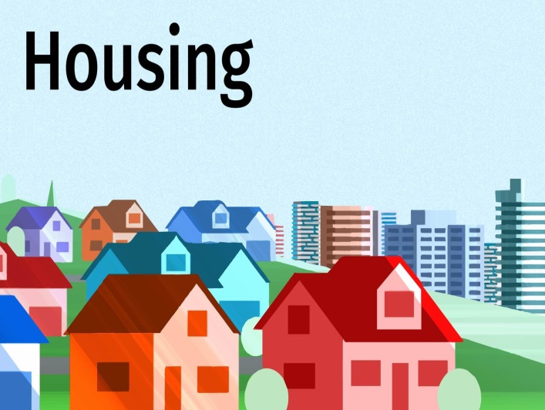
Myopic View of what the Problems are; Myopic Solutions that Sustain Inequities.
Workforce
Employment

Slide 16
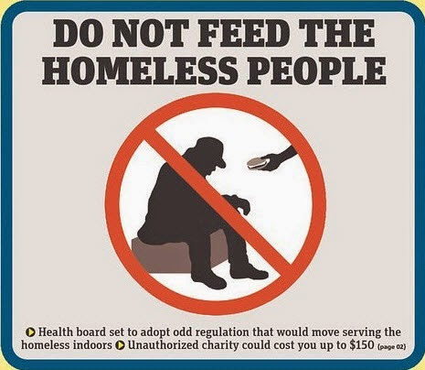
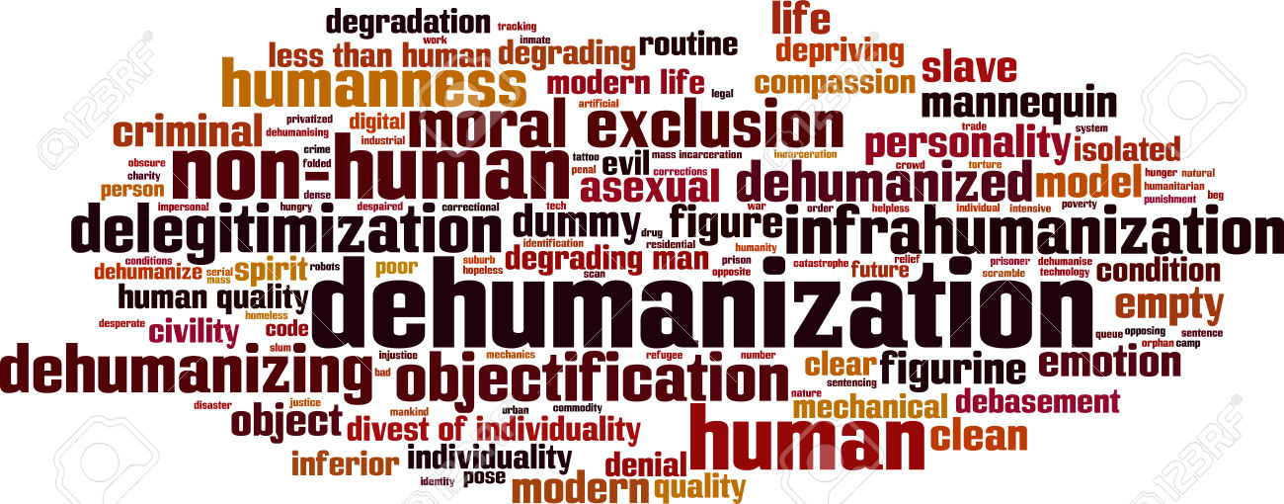
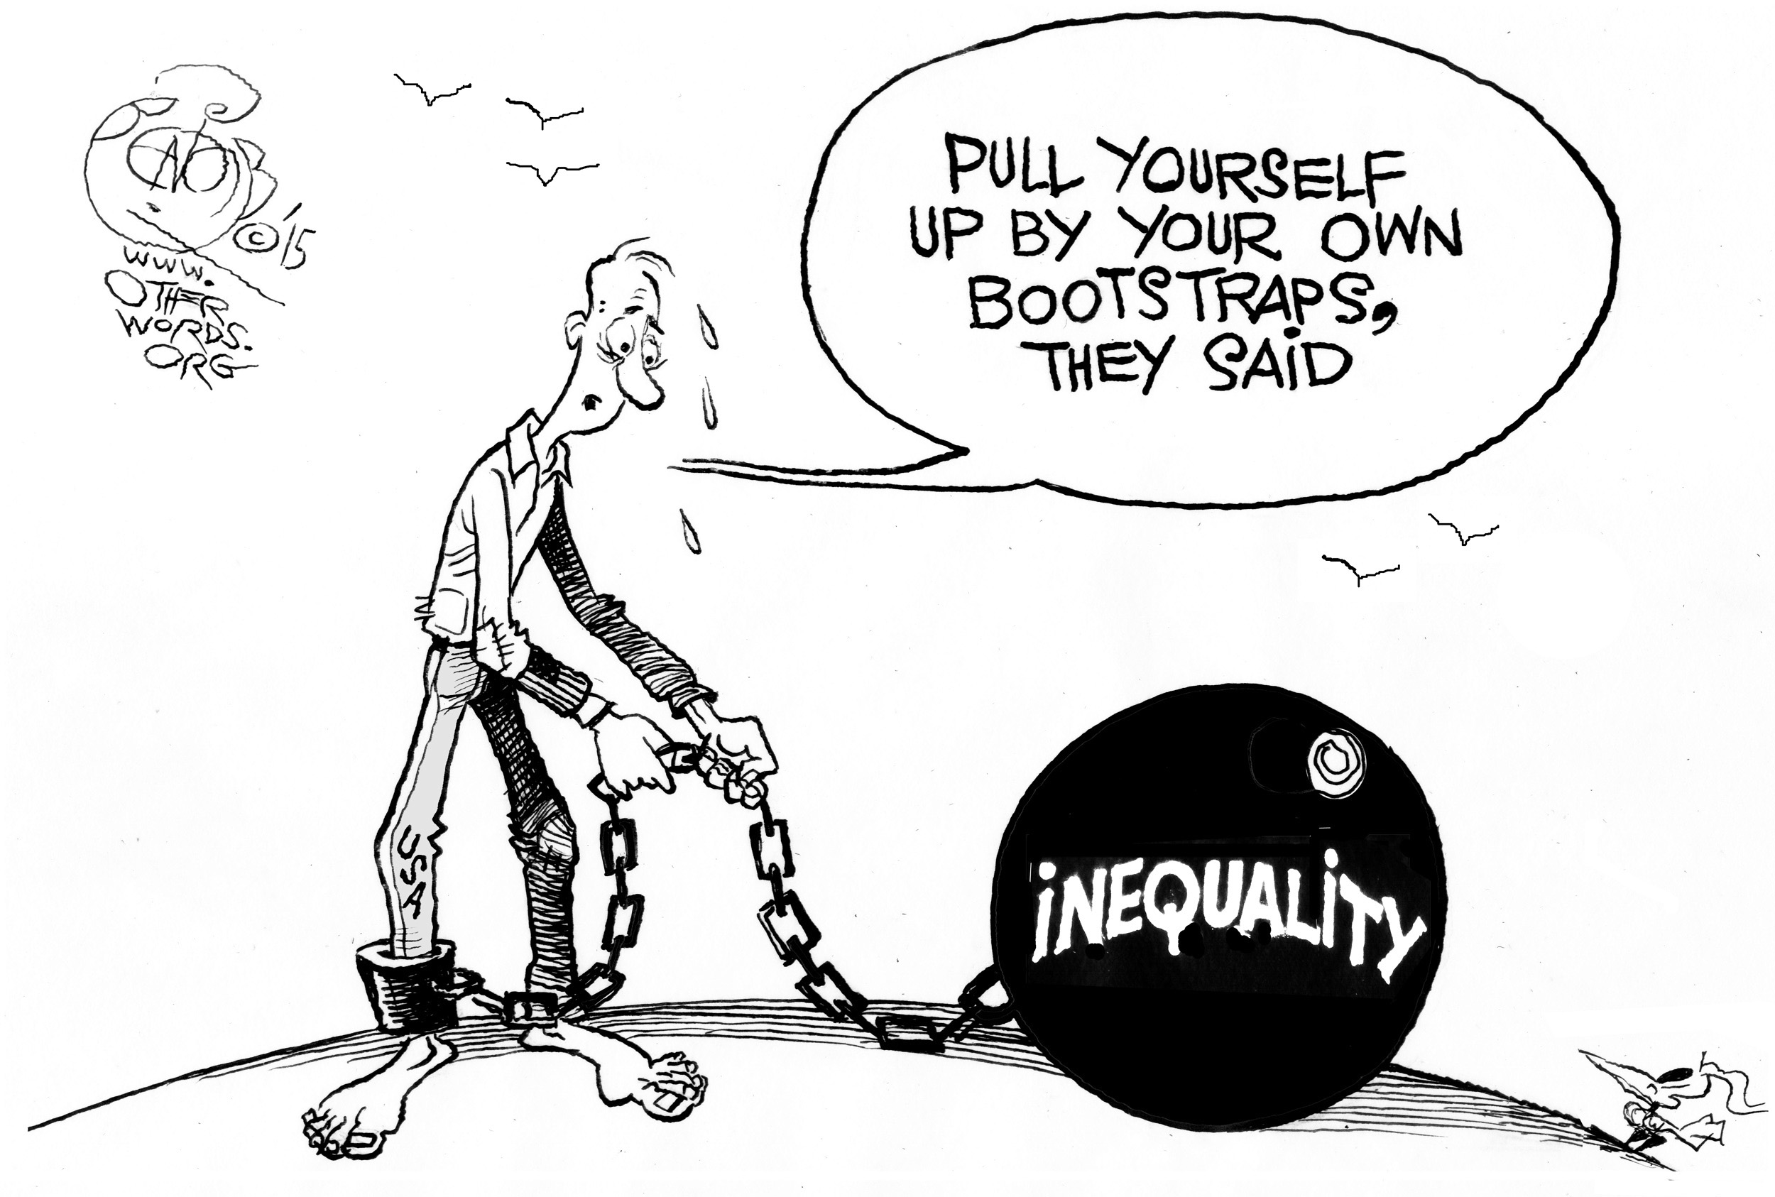
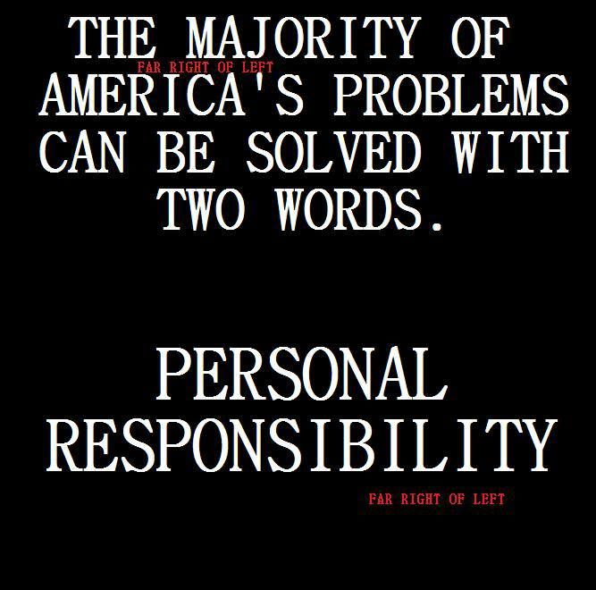
What do You Think has Been the Impact?

Slide 17
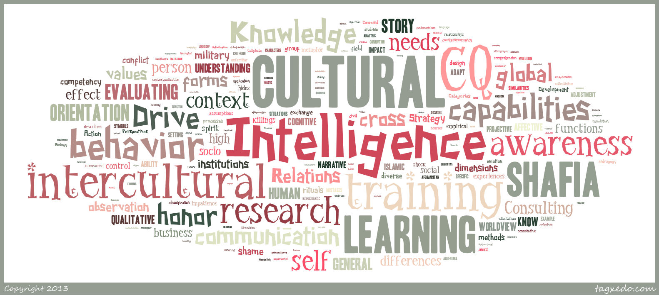
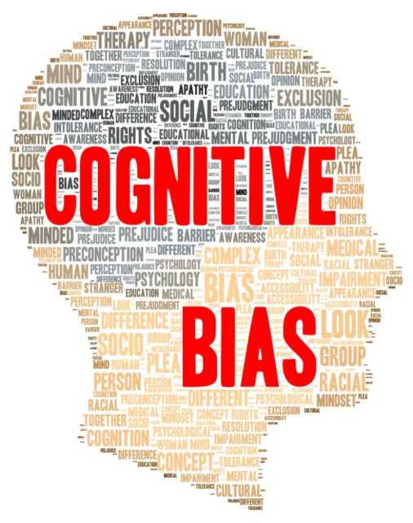
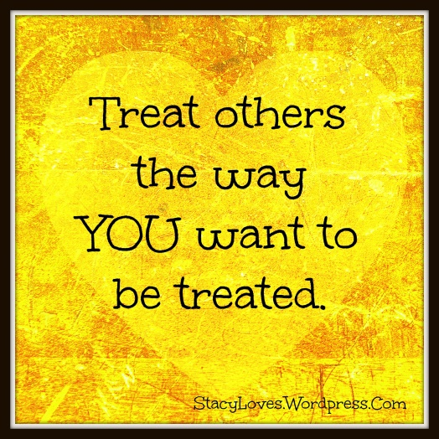

Slide 18
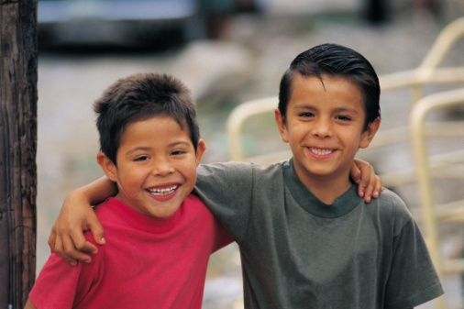
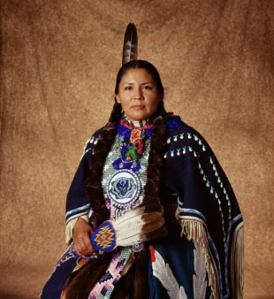
Strength Based Strategies, Techniques and Solutions

Slide 19
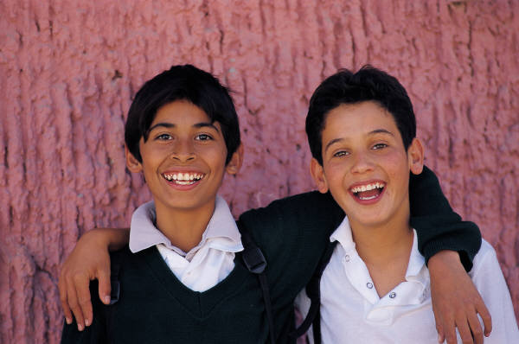
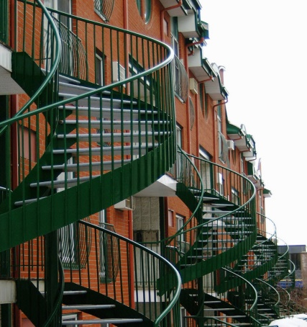
Cultural Humility
“Cultural Humility incorporates a lifelong commitment to self-evaluation and self critique to redressing the power imbalances in the patient-physician dynamic and to developing mutually beneficial and non-paternalistic clinical and advocacy partnerships with communities on behalf of individuals and the defined population.”
(Tervalon and Murry-Garcia, 1998)

Slide 20
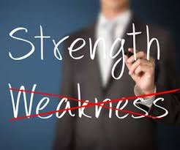
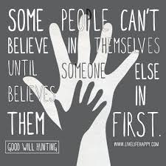
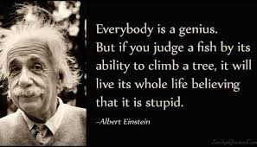
Our Language & Actions Matter

Slide 21
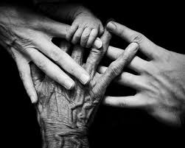
Health Equity……
“Behavioral Health Equity is the right to access quality health care for all populations regardless of the individual’s race, ethnicity, gender, socioeconomic status, sexual orientation, geographical location and social conditions through prevention and treatment of mental health and substance use conditions and disorders.” SAMHSA

Slide 22
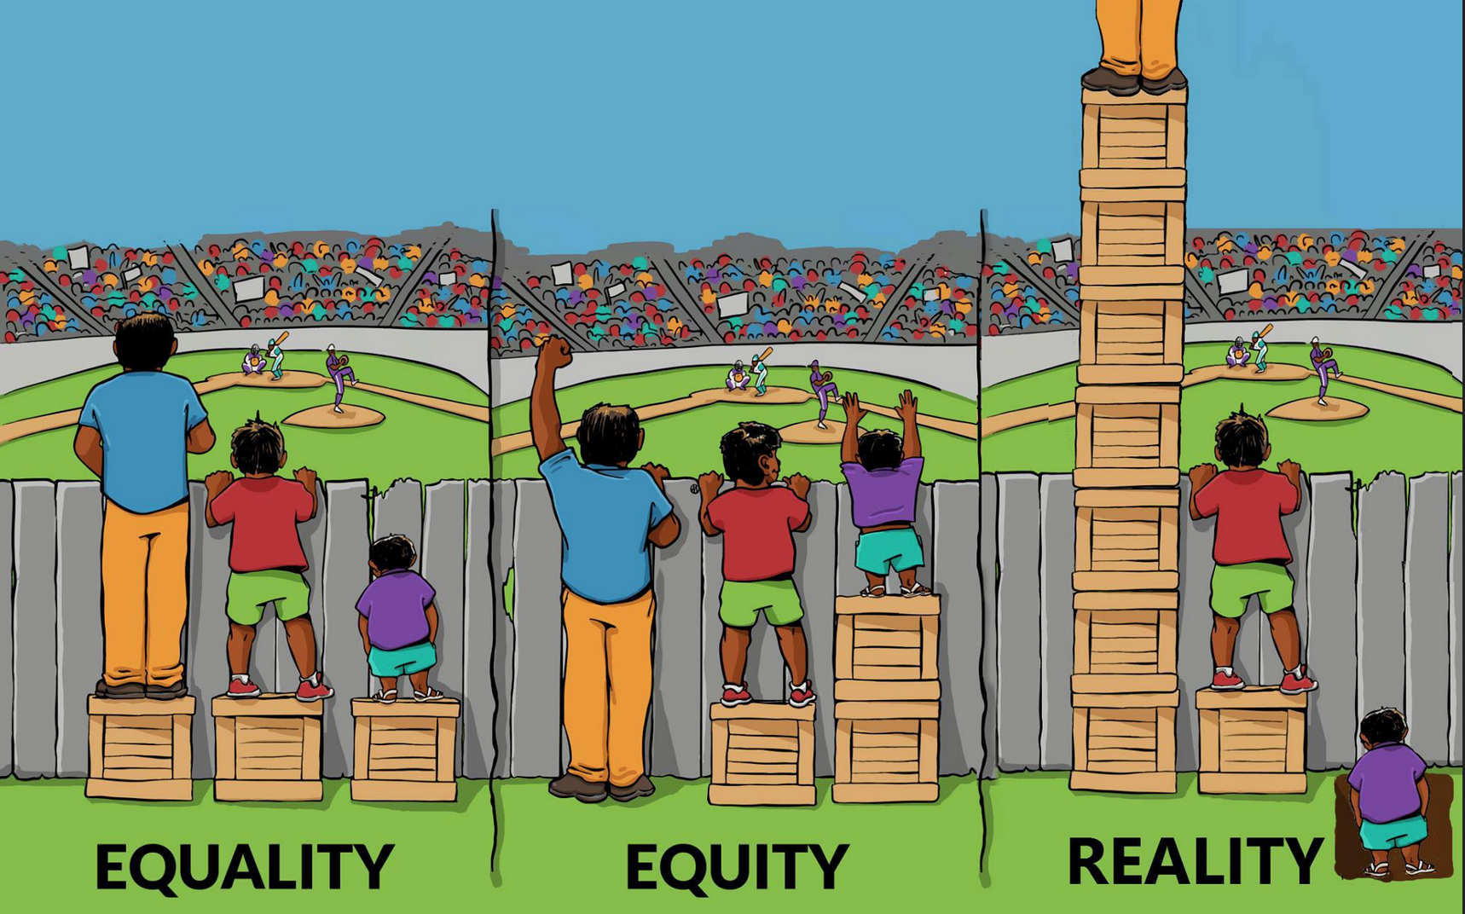
Build Equity!!!
XXXX

Slide 23
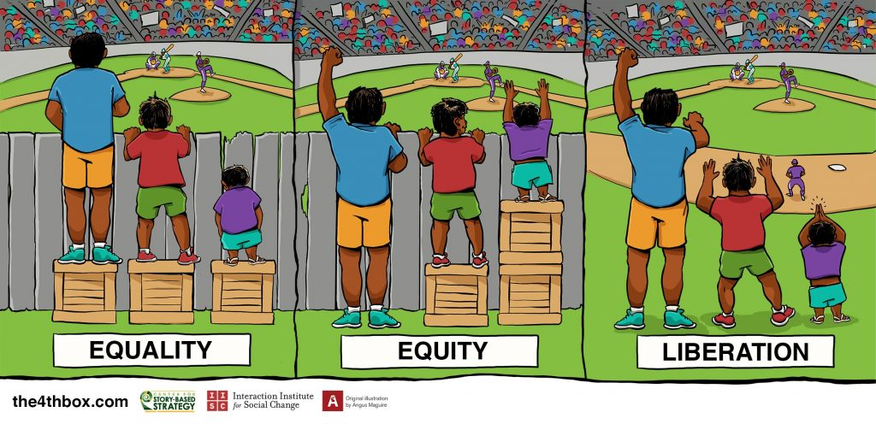
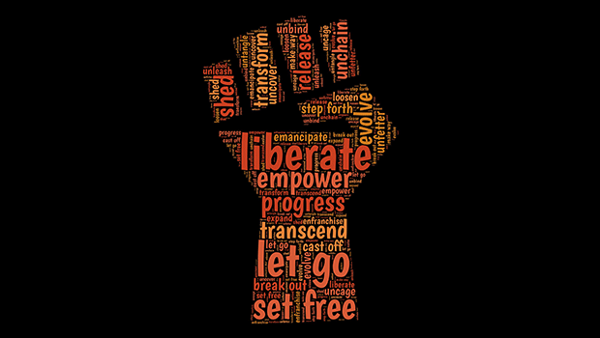

Slide 24
Building Sustainable Equity
Simply Delivering Services with Token Participation and Involvement that Sustain the Status Quo is NOT Equity.
Working Actively to Dismantle Systems of Oppression and the Structural Determinants is a Form of Community Driven Prevention and is Social Justice and Equity in Action.
Our Movement Doesn’t' Need Allies! We need Co-conspirators and Co-Defendants, people who lead with Cultural Humility.

Slide 25
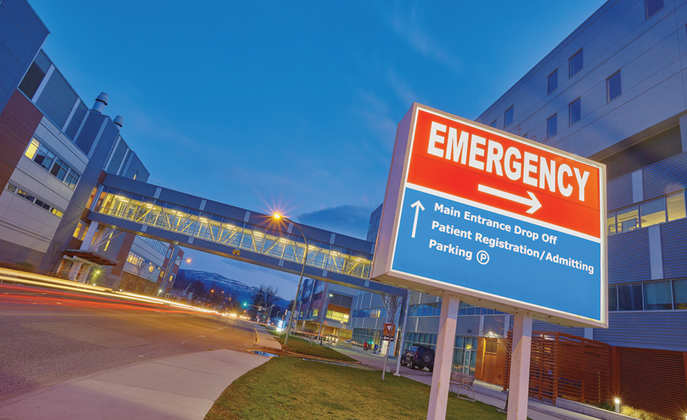
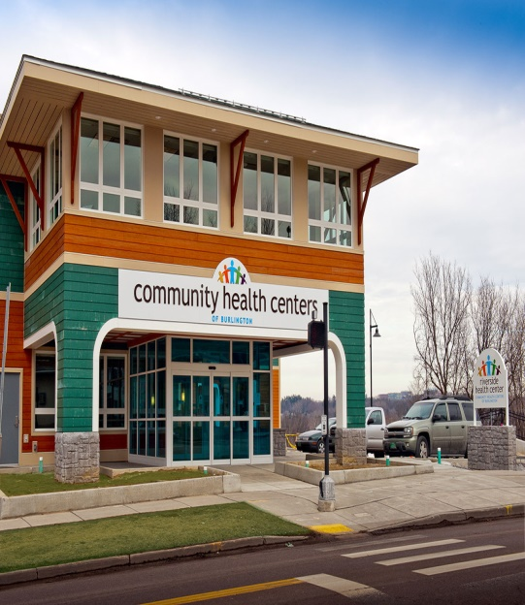
All Credible Evidence and
Outcomes Show That There are
Follow the Money……….
Single Focus Solution
Of Recovery and Wellness

Slide 26
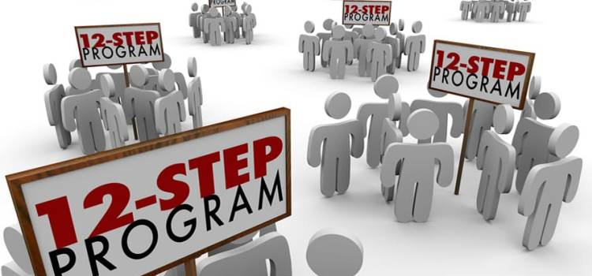
Infinite Pathways of Recovery

Slide 27
Harm Reduction is Recovery………
………..Recovery is Harm Reduction!!

Slide 28
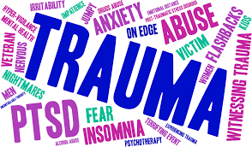
Not Just Trauma Informed...
….. Social Justice Informed!!

Slide 30
Enhanced National CLAS Standards (OMH, 2023)
The enhanced National Standards for Culturally and Linguistically Appropriate Services in Health Care are issued by the USDHHS’ Office of Minority Health to advance health equity, improve quality and eliminate health care disparities by establishing a blueprint to implement culturally and linguistically appropriate services.

Slide 31
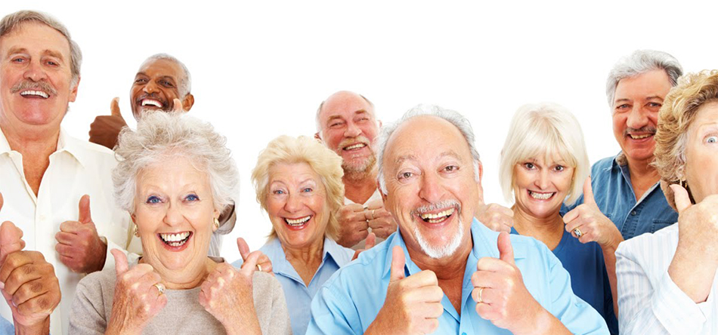
Current Workforce
Client Population
Diverse Workforce

Slide 32
Advocacy
Definition: “The act or process of supporting a cause or proposal : the act or process of advocating for something.” (Webster’s 2022)
Lower Case Advocacy is the Advocacy that I do WITH the people that I work WITH.
Upper Case Advocacy is the Advocacy I do to CHANGE Systems, Policies and Procedures.

Slide 33
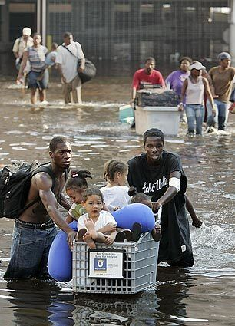
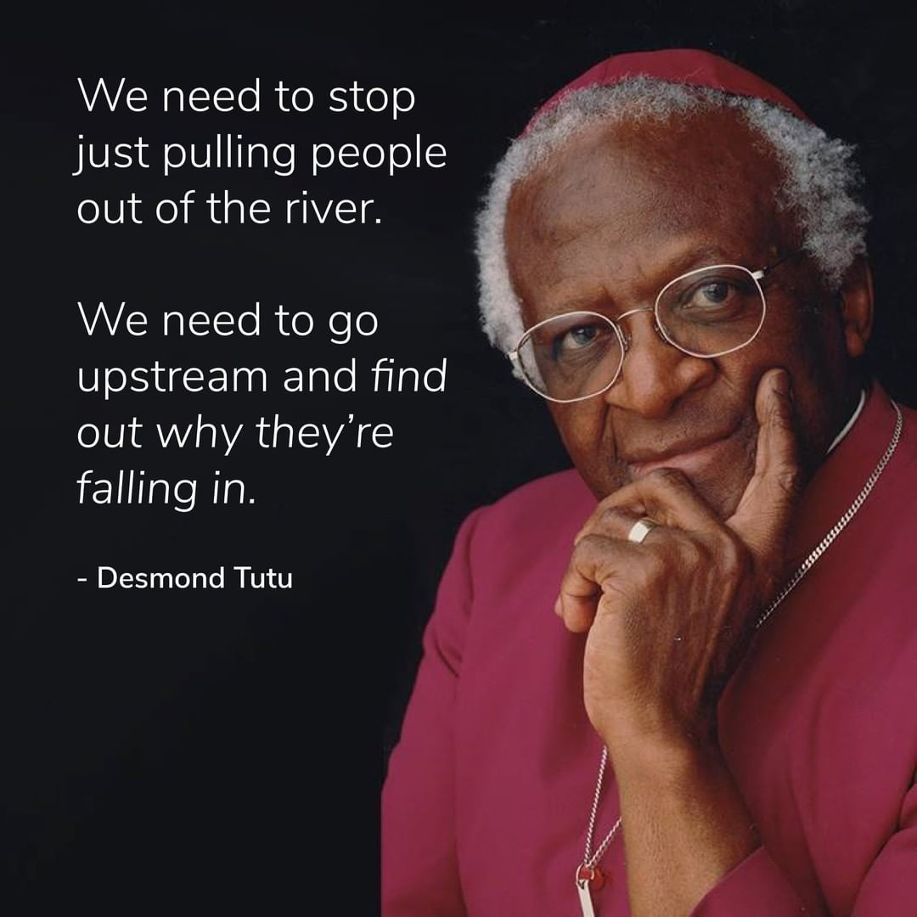
We work really hard to pull SOME people out of the “rivers” of SUDs, Mental Health challenges, Poverty, Homelessness, Incarceration, etc.
Historically, Racialized People have had NO CHOICE but do for OURSELVES and WE have.
And then there are THOSE people who are INTENTIONALLY left behind because there are PROFITS to be Extracted from Trauma, Poverty, and Unhealthy People.

Slide 34
іGracias! - Thank You!

