Slide 1
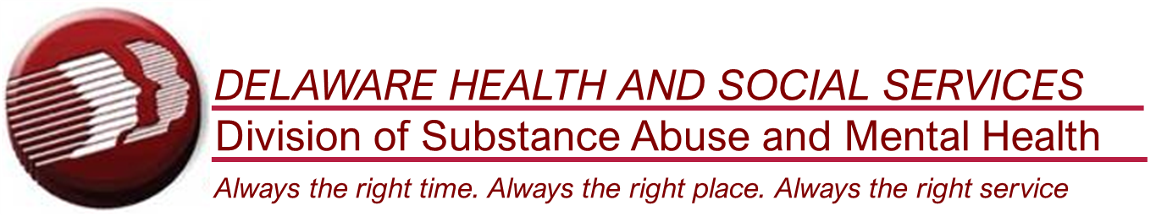
Naloxone (NaRCAN) Access training
Notes:
Classroom style presentation (30-40 minutes)
Introduce yourself to the audience
This training does NOT cover professional roles or facility response. Only for response as a good Samaritan.
Before starting, address Naloxone vs. Narcan. Naloxone=medication, Narcan=name-brand. I.E. Ibuprofen is the medication , Advil and Motrin are brand-names.
Remember to complete and submit the “Training Event Tracking Form” and event Dispensing Survey (as needed)

Slide 2
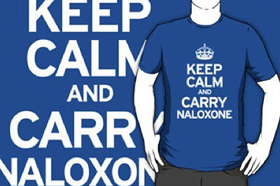
Learning objectives
By the end of the presentation, you will:
  Understand the Community-Based Naloxone Access Program (CBNAP) Standing Order
  Be able to recognize and effectively respond to an opioid overdose
  Know what naloxone is, how to store it, and how to administer it
Nigel Brunsdon, www.injectingadvice.com
Notes:
This slide isn’t meant to be read to your audience. It is included on their slide handouts, so they can read it on their own.
You will be explaining the requirements of the standing order, as they apply to your audience, and the end goal is for them to be able to recognize and effectively respond to an opioid overdose.
This is not just “Narcan training.” Only one part of the effective response is administering medication. You should point this out to your audiences.

Slide 3
CBNAP Standing Order
Identifies our required:
  Training components
  Data tracking elements
  Kit components
  And approved medication variants
https://www.dhss.delaware.gov/dhss/dph/standingorders.html
Notes:
Helpful to read, review, understand where ability to do this comes from.
Naloxone is a prescription medication; this standing order is what allows you to have and use it (after this training).
“Data tracking elements” are for ME to track the training classes and distribution, not your names/etc.

Slide 4
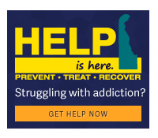
“Opioid Overdose Responder Training”
Training may be provided by:
  Approved community-based classes;
  Approved Point of Distribution training;
  Online videos;
  Direct instruction from a pharmacist or other healthcare provider.
Available classes, upcoming events, online videos can be found at:
https://www.helpisherede.com/overdose-prevention/narcan-training
Notes:
“Opioid Overdose Responder Training” is the definition used in the standing order.
Help is Here as the state’s gateway to the public for addiction and overdose related information.

Slide 5
“Opioid Overdose Responder Training”
Training must include at a minimum:
  overdose prevention techniques,
  recognizing signs and symptom of overdose;
  calling 911, airway and breathing assessment and rescue breathing;
  naloxone storage, carrying and administration;
  post-overdose follow-up and care.
Notes:
All naloxone training, regardless of format or delivery method, must include all 5 components. This includes at the pharmacy and POD events.
Prevention techniques are covered by explaining the risk factors that increase overdoses (decreasing them is a way to prevent overdose).
We will cover each of the components today.

Slide 6
Delaware and the epidemic
  Estimated 100,306 drug overdose deaths April 2020 - April 2021
  - Up 29% from the same period the year before (78,056)
    - Delaware drug overdose deaths down by 1.7% (Same Period)
  Delaware ranks 4th in the country for age adjusted deaths
      (per 100 people, 2021 CDC data)
  1st in the country for high-dose and long-acting opioid prescription
      (per 100 people, 2020 CDC data)
Notes:
*US drug overdose deaths hit a grim milestone and exceeded 100k in a 12-month period for the first-time in 2021, Spiking almost 30% from year before. DE, however, was one of only 4 states that saw a decline during same time. Although very small, this suggests a flattening of the curve.
Although improving, we still rank officially as 3rd in the country for age-adjusted deaths.
Also, although decreasing, Delaware remains 1st in the country for high-dose and long-acting opioid prescriptions.
note that the data from CDC is delayed in publishing and some statistics have not been updated since Covid began. As of this presentation (Summer 2022) the latest data for deaths is 2021, but prescriptions remains 2020.

Slide 7

NALOXONE (NARCAN) Myths
http://www.yourtrainingedge.com/top-10-training-myths/
Notes:
General warm-up – depending on audience, can be skipped if familiar.

Slide 8
NALOXONE (NARCAN) Myths
MYTH:
  Naloxone (Narcan) encourages people to take more drugs.
FACT:
  Research has shown that naloxone (Narcan) does not lead to more or riskier drug use.¹
  In fact, some studies have shown that naloxone (Narcan) administration results in a decrease in opioid use.²
(1) Jones JD, Campbell A, Metz VE, Comer SD. No evidence of compensatory drug use risk behavior among heroin users after receiving take-home naloxone. Addictive Behaviors. 2017;71:104-106. doi:10.1016/j.addbeh.2017.03.008.
(2) Wagner KD, Valente TW, Casanova M, et al. Evaluation of an overdose prevention and response training programme for injection drug users in the Skid Row area of Los Angeles, CA. International Journal of Drug Policy. 2010;21(3):186-193. doi:10.1016/j.drugpo.2009.01.003.
Notes:
The first myth is the naloxone “safety net” theory.
Many people assume that providing naloxone would encourage people to use more drugs or use more often.
However, research shows different data.

Slide 9
NALOXONE (NARCAN) Myths
MYTH:
  Naloxone (Narcan) use prevents people who use substances from seeking treatment.
FACT:
  There is no evidence to support the belief that the use of naloxone (Narcan) prevents anyone from entering treatment.
  In fact, sometimes the near-death experience can motivate an individual to seek treatment.
Bazzari, AR, et.al. “Preventing Opiate Overdose Deaths: Examining Objections to Take-Home Naloxone.” Journal of Heath Care for the Poor and Underserved, vol.21, no.4, 2010
Notes:
The second myth is that naloxone will stop someone from engaging in treatment.
Again, this is not supported by research.
The responder's action, attitude, and demeanor, when responding to the overdose, may be the trigger for that person to seek help, or not.

Slide 10
Naloxone (NARCAN) Myths
MYTH:
  Naloxone (Narcan) makes people violent.
FACT:
  When done correctly, it is very rare for someone to “wake up” from an overdose and become combative.¹
  Dosing and process is designed to minimize hypoxic brain injury and allow the patient to breathe, but not be in total opioid withdrawal.
(1) Fisher R, Odonnell D, Ray B, Rusyniak D. Police Officers Can Safely and Effectively Administer Intranasal Naloxone. Prehospital Emergency Care. 2016;20(6):675-680. doi:10.1080/10903127.2016.1182605.
Notes:
This is the most common and widespread myth.
During an overdose, the individual stops breathing, which stops the flow of oxygen to the brain. This causes what’s known as a hypoxic brain injury. When this happens, the brain enters into survival mode. If you fully reverse the overdose, and they become awake and alert, their brain is in survival mode and their “fight or flight” instinct takes over. What people call violent, is usually this fight or flight response.
The rescue breathing, dosing, and the wait time between sprays used in our response are all intended to minimize any “fight or flight” response IF the person wakes up. Ideally, they don’t wake up, and we avoid that possible outcome altogether.
We just want to restore their normal breathing. We don’t need them awake, talking, and walking around. We don’t want them awake and talking, we just want them breathing normally.

Slide 11
General information
What: Naloxone (Narcan) is an opioid antagonist
Indications: Naloxone (Narcan) is used to reverse central nervous system and respiratory depression caused by opioids (it restores normal breathing).
Onset/Duration: Following administration the onset is usually 3-5 minutes and lasts for approximately 60 minutes.
Notes:
Opioid Antagonist = drug that blocks the effects of opioids in the brain (will explain how in a minute)
Will only work on opioids and will not do anything for other overdoses or substances.
Time varies greatly based on the individual, their body, the substance, absorption rate/etc.
This is general information/characteristics of the medication naloxone.

Slide 12
Opioids
In the U.S., opioids are indicated for the following uses:
  Analgesic to combat pain (morphine, hydrocodone, oxymorphone, etc.)
  Cough suppressant (dextromethorphan)
  Diarrhea (loperamide)
  Drug detoxification and maintenance treatment
  Withdrawal Management and Medication Assisted Treatment (MAT)
    Medications for Opioid Use Disorder (MOUD)
Notes:
Opioids can be used effectively. Most often for pain, but also…
Drug detox is about clearing drugs from the system, but not treating the addiction. Which is dangerous for opioids. Withdrawal management and MAT use opioids to assist in removing the addiction.
M.A.T. for opioids is known as M.O.U.D., as M.A.T. implies that medication is not the treatment.
For M.O.U.D., medication is the treatment. M.O.U.D. uses opioids to treat the addiction
For the general public, the oversimplified analogy is to think of nicotine.

Slide 13
examples
Buprenorphine
Methadone
Codeine
Fentanyl
Hydrocodone
Hydromorphone
Meperidine
Morphine
Oxycodone
Oxymorphone
Suboxone
Subutex
Tylenol#3
Duragesic
Vicodin
Norco
Dilaudid
Demerol
Methadose
MS Contin
Oxycontin
Percocet
Opana
Heroin
Notes:
Just an FYI for the wide variety of opioids. Not a test question.

Slide 14
Risk Factors – Preventing the Overdose
The following increase the risk of overdose:
  Tolerance shifts (after treatment/detox)
  Mixing drugs
  Poor physical health
  Varying compositions and drug strength
  Changing routes (snorting, smoking, injecting)
  USING ALONE
Notes:
Limiting these things, will help to prevent an overdose.
Tolerance shifts can happen from not using in a while. Returning to the amount used prior creates a risk for overdose.
Mixing drugs, or mixing drugs with alcohol, also increases the risk of an overdose. The vast majority of overdose deaths are from “polypharm” mixes, meaning multiple substances.
Poor physical health is a risk factor for almost everything, and opioid overdoses are no exception.
Varying or changing the composition of drugs and/or the strength of the drug itself also increases the risk. This can happen when individuals change dealers or are forced to find alternative sources from what they’re used to.
Changing routes of administration also changes the way and speed the substance is absorbed.
Using alone is the greatest risk factor for overdose death, which is why it is highlighted. Emphasize that someone who is truly overdosing cannot administer naloxone, or Narcan, to themselves, so using alone is the greatest risk for death.

Slide 15
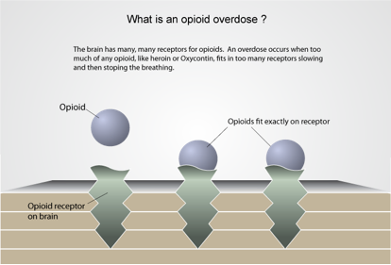
How naloxone (Narcan) works
Notes:
The first image shows how opioids attach to opioid receptors in the brain.
When too many receptors are blocked, the body begins to shut down systems. The most critical of those is breathing.

Slide 16
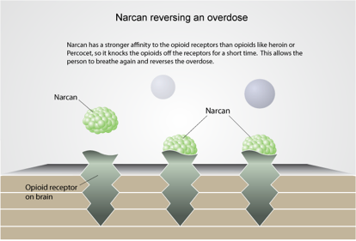
How naloxone (Narcan) works
NALOXONE (NARCAN) ONLY WORKS IF THERE ARE OPIOIDS IN THE SYSTEM
Notes:
This second image shows that naloxone comes and simply knocks the opioids off the receptors. That allows the brain to restore those systems again. It restores normal breathing.
There are two key things to highlight here.
The image uses the label Narcan. Reinforce with your audience that Narcan is just a name-brand, naloxone is the actual medication. Since Narcan is easier to say and pronounce, people just use it universally.
Second, UNLIKE the picture, the purpose is to knock SOME of the opioids off the receptors, not all of them. Knocking all of the opioids off the receptors can take the person from dying to withdrawal, and will cause them to become awake and alert, likely in the fight or flight state we talked about earlier.
The text box is also a reminder that naloxone only works on opioids and the opioid receptors. It doesn’t do anything else or affect any other substances.

Slide 17
storage and expiration
Store Naloxone (Narcan) at room temperature
  Avoid sunlight
  Do not refrigerate
  Do not leave in the glovebox
Naloxone (Narcan) has a shelf life of 36 months
  Check the expiration date
    Expired kits should be replaced with a new kit
Notes:
Naloxone should be kept at normal room temperatures, which are roughly in the 70s.
It should not be left in direct sunlight or refrigerated. We have found that many people in Delaware store medications in the refrigerator by default. A lot of people also say they will store the kit in their car, or in the glovebox, but car temperatures quickly jump to extremes in the summer and winter.
Narcan also has an expiration date, usually 36 months.
The state’s official answer is that expired naloxone kits should be replaced. They can obtain new medication on their own from a pharmacy, or they can attend another training event or use the Help is Here mail-order program to get a whole new kit. There is no option to swap out expired meds for new ones with the state.
At this point you may add in the unofficial “something is better than nothing” train of thought here. Expired and broken-down naloxone simply becomes less effective, it does not become toxic, so it is true that using expired naloxone is better than doing nothing.

Slide 18
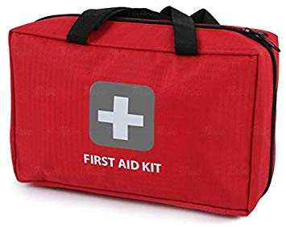
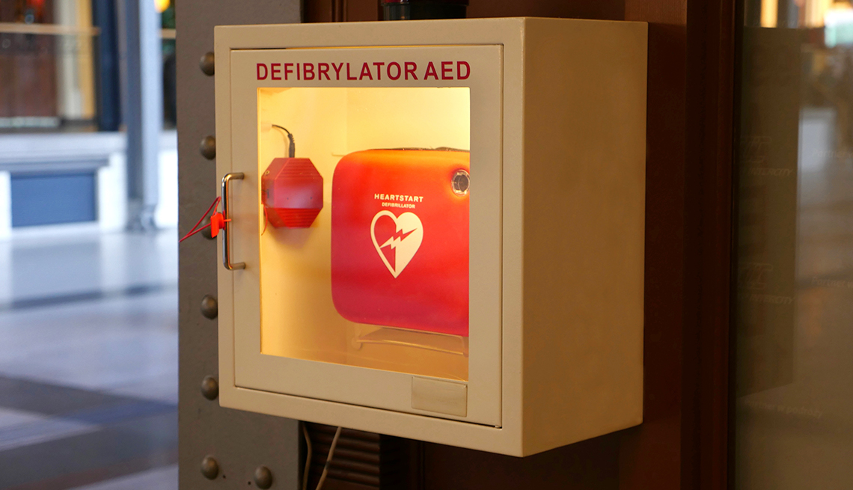
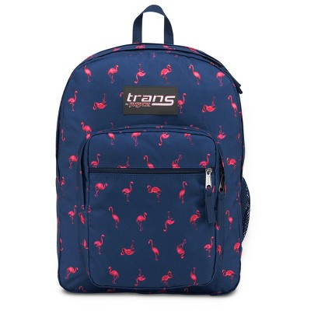
storage and expiration
Store naloxone (Narcan) in a place that is easily accessible:
  First Aid Kit or with an AED
  Medicine cabinet, TV stand, etc.
  Handbag or backpack (kept at normal room temperature)
Notes:
Narcan must be in a place that is easily accessible, and well-known.
Again, we already discussed the fact that you cannot self-administer naloxone when needed, so others must know where it is and be able to get to it.
With a First Aid Kit, or an A.E.D. for facilities are common suggestions.
Inside a medicine cabinet or TV stand at home are also common suggestions, as well as keeping it in a handbag or backpack for those that wish to keep it on them.
Again, the bag must be kept at normal room temperatures and not left outside or in a car for extended periods of time.

Slide 19
Opioid Overdose Responder
Action Steps
Notes:
The following are the actual “Action Steps” for response to an opioid overdose.
These steps are also included in naloxone kits, but in less detail.

Slide 20
Responder action steps
Step 1: Identify an Overdose
  Recognize the signs and symptoms of an overdose
Step 2: Call 9-1-1
  Call for help and dial 9-1-1
Step 3: Rescue Breathing
  If not breathing, or struggling, perform rescue breathing to provide oxygen
Notes:
Same as on the DE Overdose Guidance document in the kits.

Slide 21
Responder action steps
Step 4: Give naloxone (Narcan)
  Administer naloxone to restore normal breathing
  If not breathing, or shallow breathing, continue rescue breathing
Step 5: Stay until help arrives
  If there is no change in 3-5 minutes, administer another dose of naloxone
  Stay with the person until help (medical professional) arrives
Notes:
Again, administer naloxone only to restore normal breathing.

Slide 22
Step 1: Recognize signs and symptoms
Very Intoxicated/High | Overdosed
Muscles are relaxed | Pale, clammy/Bluish, grey skin
Speech is slowed or slurred | Breathing is infrequent or has stopped
Looks sleepy | Deep snoring or gurgling (“death rattle”)
Responsive to shouting or sternal rub | Unresponsive to any stimuli (sternal rub)
Normal heart rate and/or pulse | Slowed or no heart rate and/or pulse
Normal skin tone | Blue/Grey lips and/or fingertips
Notes:
Two primary indicators for the public are breathing and unresponsiveness.
Breathing that is infrequent or has stopped completely is the first indicator of an overdose, and the lack of response to a painful stimuli is the second.
Highlight the sternal rub as the preferred method for checking responsiveness (demonstrate as needed)

Slide 23
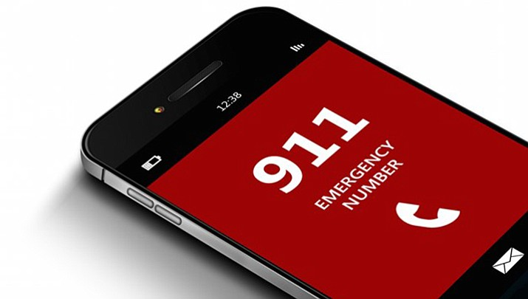
Step 2: Call 9-1-1
https://www.dcourier.com/news/2017/aug/12/column-when-should-you-call-911/

Slide 24
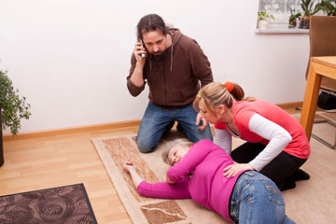
Step 2: Call 9-1-1
TELL the dispatcher that you suspect an opioid overdose!!
Describe exactly where you are with details so they can easily find you (i.e. 3rd floor, or in the bathroom).
Describe what you see: “Not breathing, turning blue, unconscious, non-responsive, etc.”
When EMS arrives, tell them what you know about what the person may have been using and what you have done—as much information as possible.
https://www.auroragov.org/residents/public_safety/911_communications/when_to_call_911
Notes:
Contrary to national Harm Reduction Coalition advice… TELL the dispatcher that you think this is an opioid overdose. Delaware dispatchers can help walk you through naloxone administration instructions. This also allows EMS to start troubleshooting other causes ahead of their arrival if naloxone is not working.
“…as much information as possible.” plays into liability protections.

Slide 25
9-1-1 Concerns
Criminal Immunity: Title 16, Chapter 47, § 4769 - Criminal immunity of non-felony offenses for persons who suffer or report an alcohol or drug overdose or other life-threatening medical emergency, if:
    reports the emergency in good faith, and the person provides all relevant medical information
Good Samaritan: Title 16, Chapter 68, § 6801 - Persons rendering emergency care exempt from liability
    Individuals providing emergency care in good faith, without gross negligence, etc. are immune from liability for civil damages.
Notes:
It is not essential that audience knows the difference, these two laws are often lumped together and collectively referred to as “Good Samaritan” law/protections. Focus on one or the other depending on your audience.
Criminal Immunity – mainly concerns from friends calling 9-1-1, fear of getting in trouble or their friends in trouble. This law provides immunity for non-felony offenses (so not everything), IF the person reports it in good faith, and provides all relevant medical information. Again, relaying information to E.M.S. and 9-1-1 actually helps to ensure they are protected from low-level offenses, like possession, paraphernalia,
Good Samaritan – covers you taking this class. By taking the class, they are not being “grossly negligent” because they have been trained on how to properly respond and administer this prescription medication. As long as they don’t do something completely off the wall, this covers them from civil damages should something go wrong or their attempt to save someone be unsuccessful

Slide 26
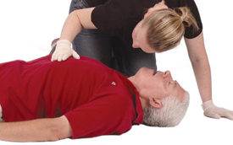
Step 3: Rescue breathing
Check for breathing:
  Look to see if the chest is rising and falling
  Listen over the mouth and nose for breathing sounds
  Feel for the breath against your cheek for 10 seconds
If not breathing, start rescue breathing.
https://healthywa.wa.gov.au/Articles/A_E/DRSABCD-action-plan
Notes:
After recognizing the overdose, and activating 9-1-1, step 3 is to start rescue breathing.
To check for breathing, we use the Look, Listen, and Feel method.
CPR only if trained/certified and indicated.
After the look, listen, and feel for breathing, if they’re not breathing, or having difficulty breathing, your audience would start providing rescue breathes.

Slide 27
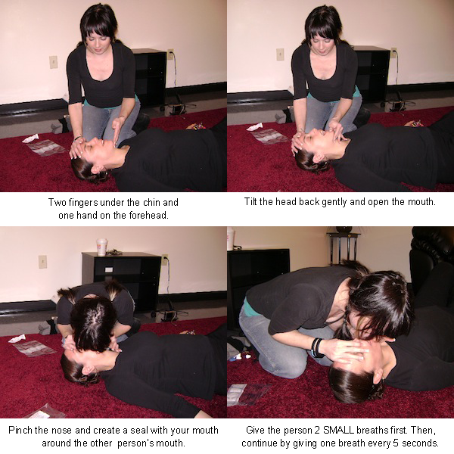
Step 3: Rescue breathing
https://harmreduction.org/issues/overdose-prevention/overview/overdose-basics/responding-to-opioid-overdose/perform-rescue-breathing/
Notes:
Head tilt, chin lift method. Enough air to make the chest rise. Initiate with 2 rescue breaths, PRIOR to naloxone. (link back to hypoxic brain injury)
Plastic face shield/barrier device is included with the kits.

Slide 28
Step 3: Rescue breathing
Place the person on their back.
Tilt their chin up to open the airway.
Check to see if there is anything in their mouth blocking their airway (such as gum, undissolved pills, syringe cap, etc.). If so, remove it.
Plug their nose with one hand, and give 2 even, regular-sized breaths. Blow enough air into their lungs to make their chest rise. If you don’t see their chest rise, tilt the head back more and make sure you’re plugging their nose.
Breathe again. Give one breath every 5 seconds.
Notes:
Again, head tilt, chin lift method for those not familiar (printed handouts).
2 initial breaths, then 1 breath every 5 seconds after naloxone.

Slide 29
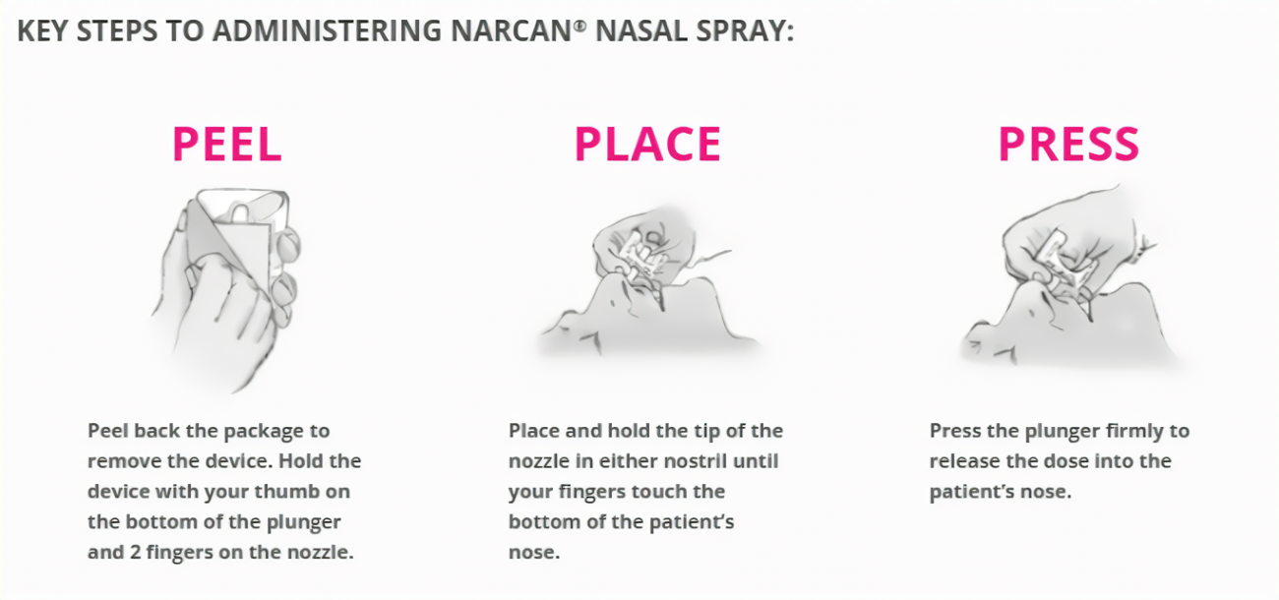
Step 4: Give NALOXONE (NARCAN)
Notes:
Step 4 is to give naloxone or Narcan.
The Narcan name-brand nasal spray is 3 steps just like an allergy nasal spray is. It’s a one-shot plunger, so it all goes into a single nostril.
These instructions are also printed and included in the kits.
.

Slide 30
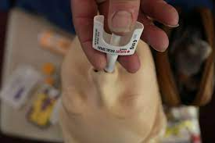
Step 4: PROPERLY Administer NALOXONE (NARCAN)
https://www.jems.com/articles/print/volume-41/issue-3/special-focus-resuscitation-recommendations/prehospital-naloxone-administration-for-opioid-related-emergencies.html
Notes:
This slide highlights the correct angle of this device to the nose.
The device needs to be pointed toward the brain, which is where you want the medication to go. If it is not angled up the nostril, and pointing to the throat, the liquid will sit in the nose and not be absorbed effectively.

Slide 31

Step 4: Give Naloxone (NARCAN)
Remember, the goal of naloxone (Narcan) administration is to restore normal breathing.
https://copd.net/clinical/breathing-treatments/
Notes:
Repeat: goal/purpose of naloxone is ONLY to restore normal breathing. Not awake and talking, just breathing.
We don’t want them awake, talking, and walking around, we just want them breathing.
This means rescue breaths and naloxone should be administered until the individual starts breathing, and then stop.

Slide 32
Step 4: Give Naloxone (NARCAN)
Administer naloxone (Narcan) to restore normal breathing.
Naloxone (Narcan) is reversing the effects of an opioid; some withdrawal effects may occur.
However, the amount provided in the naloxone (Narcan) kit and the method with which it is administered should NOT cause severe withdrawal symptoms.
Notes:
This is the disclaimer slide.
Even when they administer one dose, because they don’t know the person’s metabolism, the substance, strength, and the reaction going on inside the body, there still may be withdrawal effects. The most common effect that is seen in the field is vomiting.
However, the reassurance is that the doses we are providing, and the instructions you are giving them, is designed to minimize that from happening. So, there should not be any severe symptoms.

Slide 33
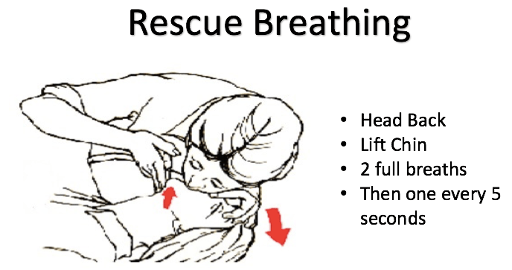
Step 4: Give Naloxone (NARCAN)
If still not breathing normally, continue rescue breathing
- Prior to Naloxone (Narcan)
http://nhhrc.org/interview-overdose-prevention-response-with-makin-it-happen/
Notes:
After administering naloxone or Narcan, if the patient is still not breathing normally continue rescue breathing.
Again, the method is head back, chin lifted. Start with 2 full breaths initially and then 1 breath every 5 seconds after that.

Slide 34
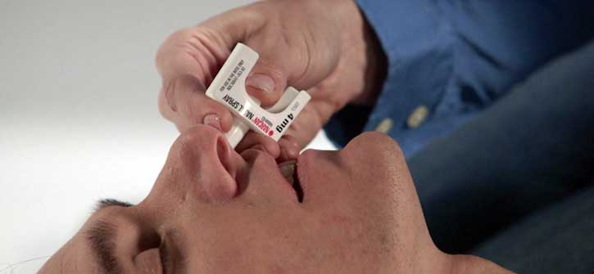
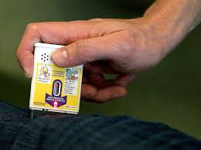
Step 4: Give Naloxone (NARCAN)
If there is no change in 3-5 minutes, administer another dose
Notes:
After 3-5 minutes, if there is no change in the person’s condition, you should administer the second dose (i.e., the second box in the kit).
All variants of naloxone must be distributed with 2 doses per the standing order, so there should always be a second dose readily available to them.

Slide 35
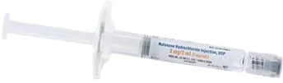
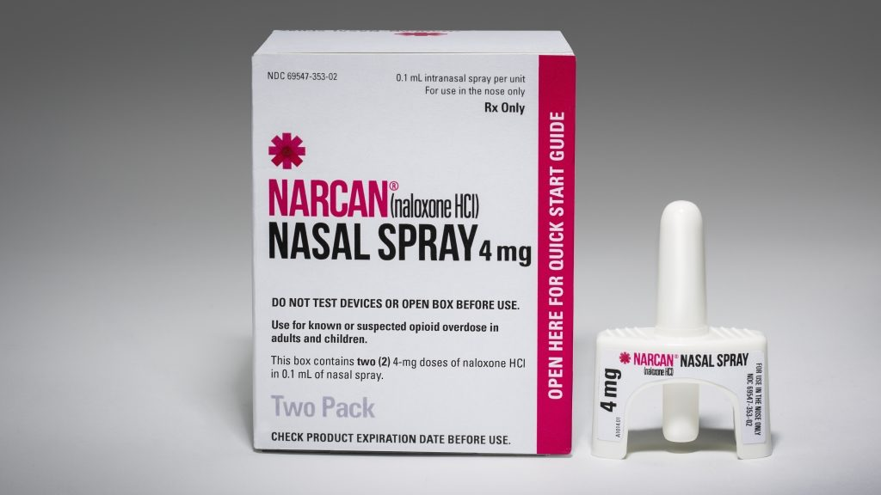
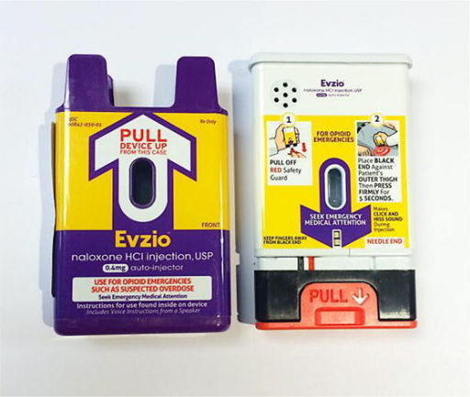
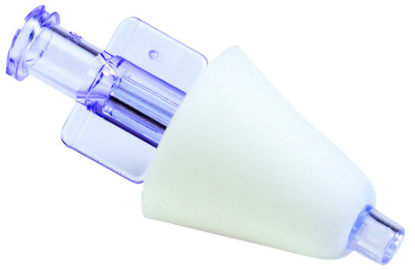
Types of naloxone
Cheapest
Most Expensive
Intranasal Kit with atomizer
Narcan® Nasal Spray
Auto-injector
http://choopersguide.com/content/intranasal-naloxone.html
https://openi.nlm.nih.gov/detailedresult.php?img=PMC4470965_40122_2015_35_Fig2_HTML&req=4
Notes:
These are the three general types of naloxone that are approved under the standing order.
Prices will vary from each pharmacy location, including those of the same chain. Arranged from least expensive to most expensive.
Delaware Medicaid has waived the copayment for naloxone in Delaware. Those with Medicaid can obtain naloxone, without a copay, at any pharmacy that participates in the CBNAP standing order (all major chains and food store pharmacies participate, list is on Help is Here).

Slide 36
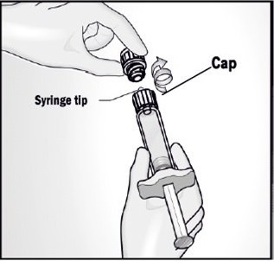
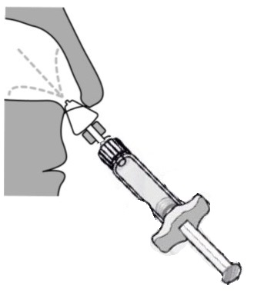
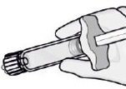
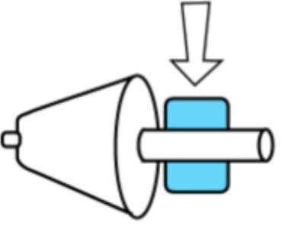
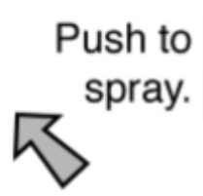
Types of naloxone
Other variants:
3.
Insert white cone into nostril, give a short push on end of plunger to spray naloxone into nose:
2. Grip plastic wings and gently screw on the mucosal atomizer device.
One half into each nostril.
1. Remove the safety cap
4.
If no reaction in
3-5 minutes, give the second dose.
Atomizer
Syringe
Notes:
Intranasal Kit and Atomizer is the second most common variant in Delaware.
Simply pop the cap in step 1, attach the atomizer into the syringe barrel with a ½ turn in step 2, and spray ½ of the vial into each nostril during in step 3.
The atomizer is helpful, but not essential. It turns the liquid into a fine mist so that it is more easily absorbed in the nasal passageway, the way the nasal spray does automatically.
However, even if it is lost, spraying the liquid into the nostril will work, just not as quickly.
The atomizer is also clean, not sterile, so even though it comes in its own little plastic bag, so they can open the bag ahead of time and just leave it in the kit.

Slide 37
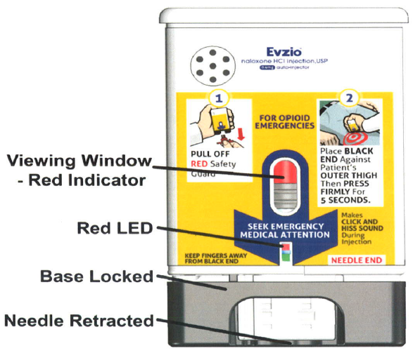
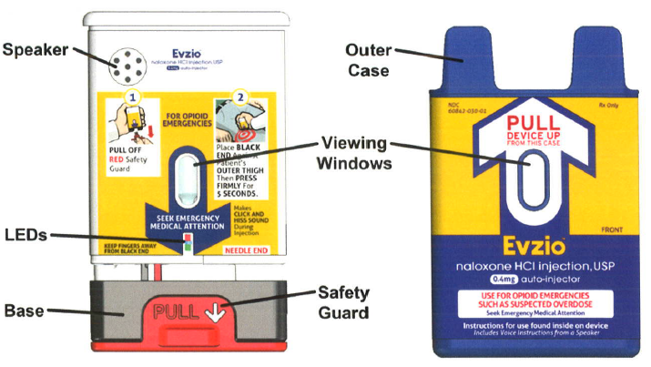
Types of naloxone
Other variants:
Notes:
Auto-injectors are much less common, and currently no longer in production. So, this slide can be reviewed very quickly.
The auto-injectors talk to you and walk you through the steps, just like an Epi-Pen. Auto-injectors also include a trainer device.
Benefit of the viewing window on auto-injector and the kit w/ atomizer = ability to see/check medication. Cloudy or particulates floating inside means the medication has broken down and should be replaced. Narcan name-brand does not have a viewing window to see the medication.

Slide 38
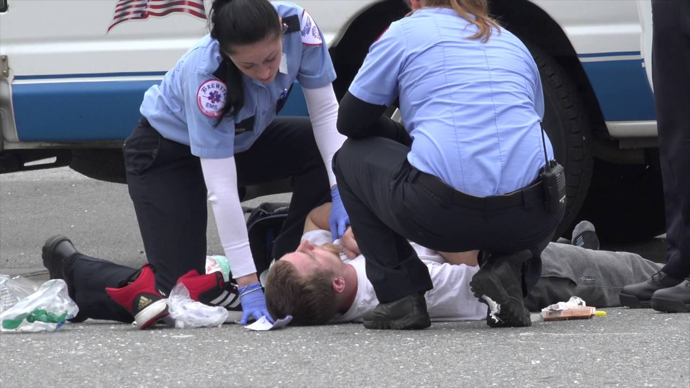
Step 5: Stay until help (medical professional) arrives
Notes:
The final action step is to stay with the person until help arrives.
Importance of ensuring 9-1-1 is activated and having that next level of medical care arrive.
More on why this is important is covered in a minute.

Slide 39
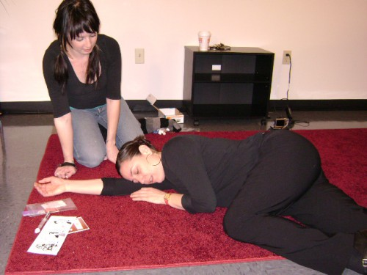
Recovery Position
If you need to leave for any reason (call 911, get naloxone, etc.) place the person in the recovery position.
Lay the person slightly on their side, their body supported by a bent knee, with their face turned to the side.
This will help to keep their airway clear and prevent them from choking on their own vomit if they begin to throw-up.
https://harmreduction.org/?s=recovery+position
Notes:
Just like in CPR, if you need to leave for any reason, you should leave the person in the recovery position.
Remember, one of the most common side effects of withdrawal and overdose is vomiting, which can turn into choking if they are not in the recovery position when you leave them.
Even when staying with the person after they start breathing, moving them to the recovery position will avoid this happening as well.

Slide 40
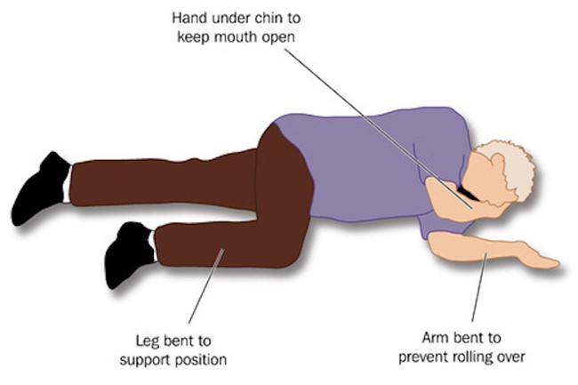
Recovery Position
https://www.healthnavigator.org.nz/health-a-z/r/recovery-position/

Slide 41
What to expect after giving NALOXONE (naRCAN)
While many people will react quickly, it will take a few minutes for the naloxone to have an effect.
Remember, the goal of naloxone (Narcan) is to restore normal breathing.
Naloxone (Narcan) blocks opioids from acting, so withdrawal symptoms may occur.
  However, the dose and administration instructions provided should not lead to severe withdrawal symptoms.
  It is important that one does not use again until the naloxone wears off so that a re-overdose does not occur.
Notes:
Note that it will take a few minutes for the naloxone to work. It needs to get up into the brain to have an effect, so it’s not instant.
The only goal is to restore normal breathing.
Disclaimer that some withdrawal symptoms may occur, but we have learnt how to do this in a way that to minimizes it from happening.
A re-overdose is possible. The next slide will explain this more.

Slide 42
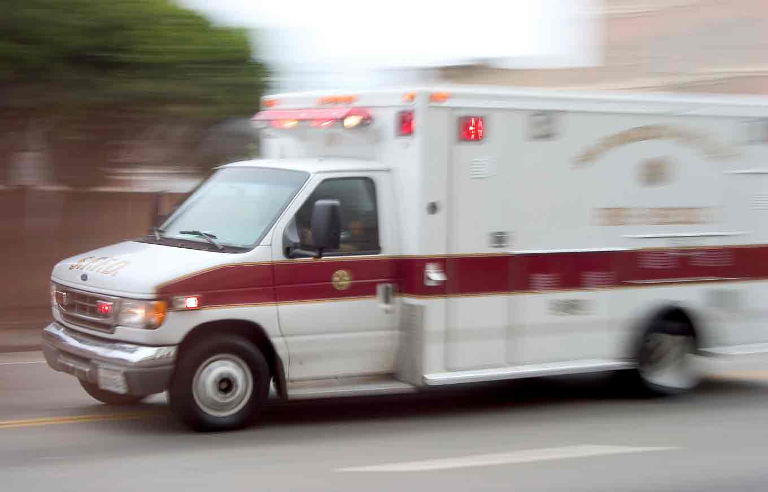
What to expect after giving NALOXONE (NARCAN)
Naloxone (Narcan’s) effects last about 30-90 minutes.
  Many opioids last longer, so when the naloxone wears off, it is possible that the person may go into overdose again (without taking any more substances).
It is essential that the person be seen by a medical professional after an overdose (for example, EMT or a paramedic).
https://blog.credit.com/2013/10/consumer-rage-ambulance-ride-69734/
Notes:
Naloxone only lasts about 30-90 minutes, roughly 60 minutes on average. However, most opioids last in the body longer than naloxone does. It is possible that the person re-overdoses (also known as re-narc-ing) on the same drugs without taking more of them. Again, this is why it is important that they get to the next level of care.
Again, it may not be an opioid overdose, they may have other medical issues, and there may be more than one substance causing the overdose. The naloxone will only work temporarily on the opioid. So it is essential that they be seen by a medical professional.

Slide 43
What if you don’t have NALOXONE (NARCAN)?
Call 9-1-1
Start rescue breathing and continue until medical help arrives.
  If there is more than one person present, take turns.
https://harmreduction.org/issues/overdose-prevention/overview/overdose-basics/responding-to-opioid-overdose/perform-rescue-breathing/
Notes:
…or you run out.

Slide 44
Naloxone Acknowledgment Agreement
Used when purchasing a naloxone kit at a participating pharmacy
Mail-Order Program:
  www.HelpIsHereDE.com
Notes:
Again, all major chains and food store pharmacies participate (list on Help is Here website).
Signature on the form does not need to be legible. There is no identifying information on the page. Just new or refill of naloxone, and where your training was from.
Mail Order requests-Help is Here website

Slide 45
DHSS Opioid Rescue Kit Components
Notes:
IF PROVIDING KITS – OPTIONAL REVIEW OF ALL COMPONENTS
Overdose Guidance Document (2-sided, teal border)
Naloxone Instructions (both written and pictogram, with tips)
2 doses of Narcan (Naloxone, 2 boxes of 4mg)
Barrier device/face shield for rescue breathing (keychain)
Treatment Connection Postcard

Slide 46
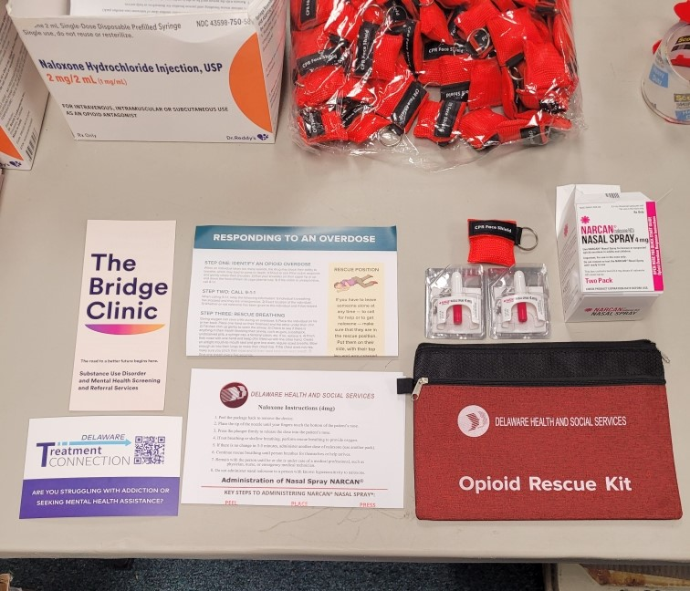
DHSS Opioid rescue kit
2 Doses of Narcan
Face Shield
Instructions page
Treatment Connection Postcard
Overdose Guidance Document
Bridge Clinic Document
Notes:
As mentioned, each kit will contain;
Two doses/boxes of Narcan and a face shield
The instructions page has both written and the pictogram instructions, as well as the Look, Listen, Feel method for breathing, and carrying and storage tips at the bottom.
Overdose guidance Document
Treatment Connection Post Card
Mention the OpiRescue smartphone app. This app will allow someone to launch and walk through the overdose response action steps, with voice over instructions. You can also call 9-1-1 right from the App, so you can literally set the phone down next to the person, take out your kit and go through the overdose response steps. The app also has resources, links to Help is Here, locations of participating pharmacies, and a function to anonymously report the use of naloxone in the community. We’ll talk about that function more in a minute.

Slide 47
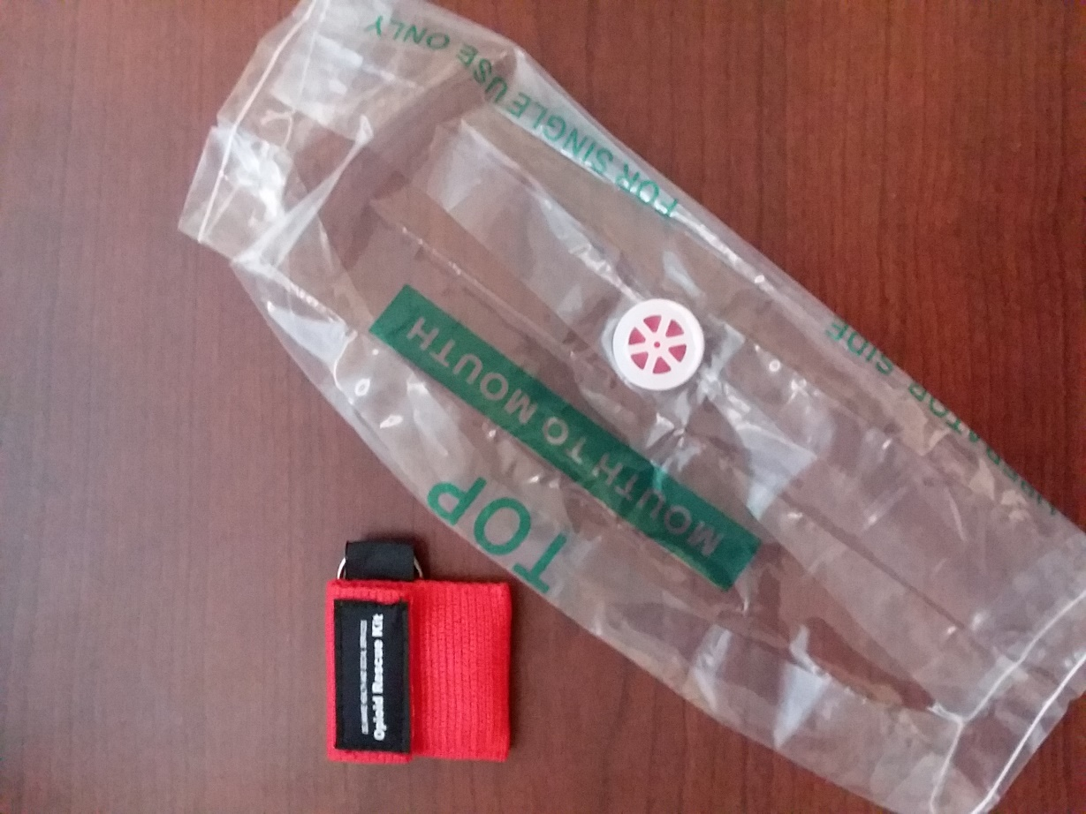
DHSS Opioid rescue kit
Barrier device / face shield
Notes:
The barrier device is folded inside a keychain pouch and is a simple sheet of plastic with a one-way valve.

Slide 48

Questions?
https://www.huffpost.com/entry/asking-questions-is-really-hard_b_7052722

Slide 49

Contact
DSAMH Naloxone Support Team
Narcan.Train@delaware.gov
302-255-2777

